Slide 1


INDIVIDUAL PROJECT
ONLINE SHOPPING SITE WITH AI WEB CRAWLING SYSTEM
BY JEONGWOO KWAK

Slide 2
Why this Project?
Many online store managers still rely on manual methods for collecting product information.
The recent surge in hacking incidents has led to an increase in complaints from online shoppers about e-commerce platforms and reduced credibility.
Obstructive advertising, badly designed site layout, and uncomfortable category placement and filtering capabilities cause inconvenience to users.

Slide 3

Project aim
Develop an AI web crawling system for online shopping site administrators to swiftly gather product information
Focusing on improving the site's UI/UX for a better shopping experience.
Project objectives
Provide an AI-Based Web Crawling System
Simplify Product Information Collection
UI/UX Enhancement for Buyers
Data Security and Privacy using MongoDB

Slide 4
Problem statement and Solutions
- Many websites including online shopping malls are hacked for lack of security
- The manual collection of product information from the official website or various sales sites causes many problems
- User convenience is reduced due to inconvenient UI/UX design elements on the website
- Lack of providing Selling Points
+ Data protection Using MongoDB and powerful encryption
+ Collecting automated product information using an AI-based web crawling system
+ Improving user convenience by improving the uncomfortable UI/UX design on the Website
+ Provides selling point sections for all product

Slide 5
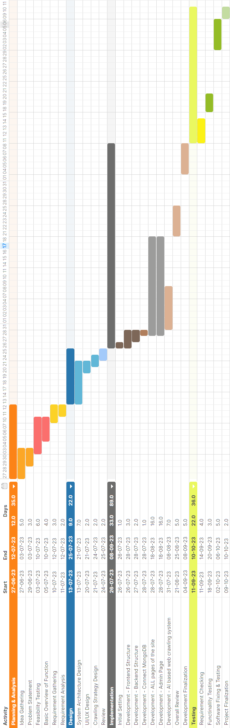
Project Plan(Gantt chart)

Slide 6


Technical Literature Review
Development Tool:
Visual Studio Code
Tools used in creating online shopping site:
JavaScript
Node JS & React JS
MongoDB
Tools used in creating AI web crawling system:
Python
Beautiful Soup
OpenAI API(ChatGPT)

Slide 7
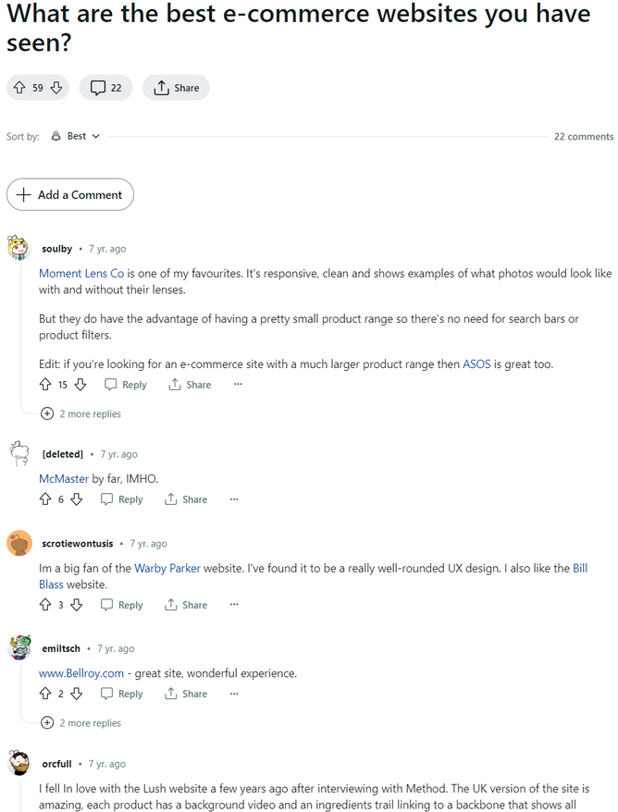
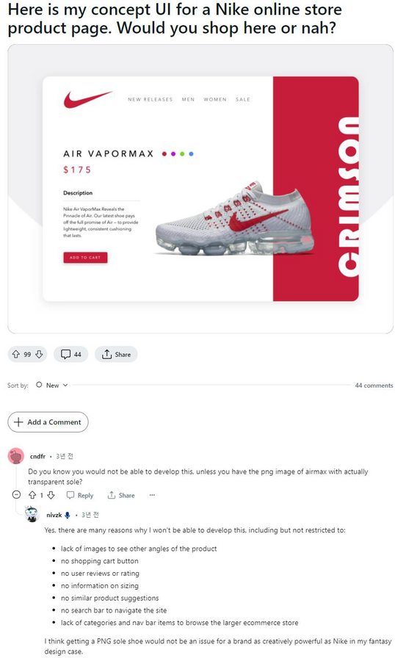
Research Methodology
Project Methodology
To gather user feedback on the UI/UX of an online shopping site, I visited online blogs and communities where users discussed their experiences.
I collected diverse opinions and perspectives from these posts and also analyzed the comments on the posts to gain insights into how users perceive various UI/UX elements

Slide 8

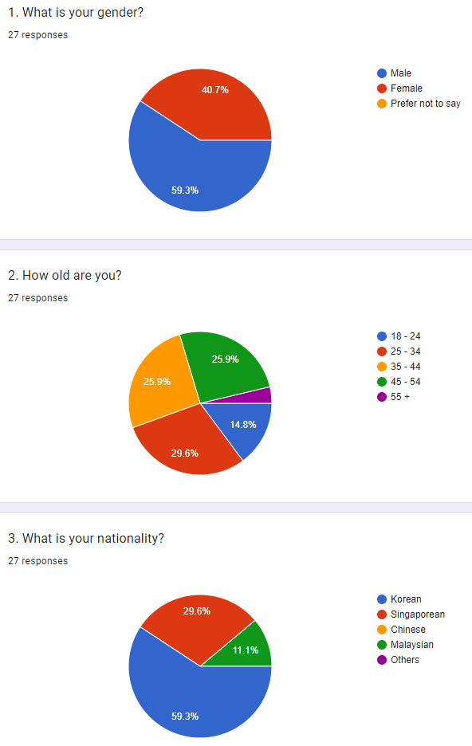
Requirements Gathering:
Questionnaire
27 Responses
15 Questions
3 Demographic Questions
12 UI/UX questions on online shopping sites

Slide 9
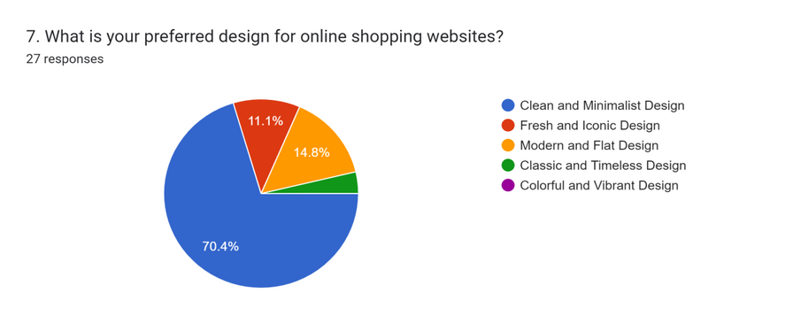
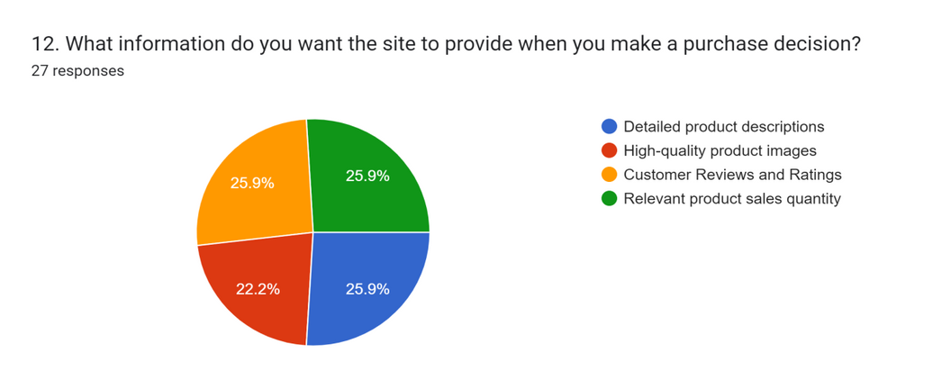
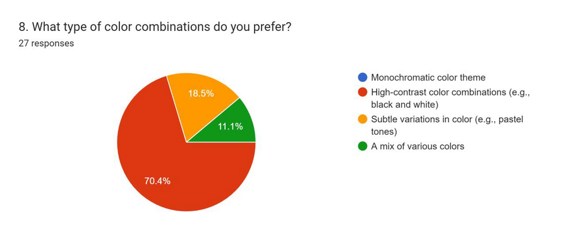
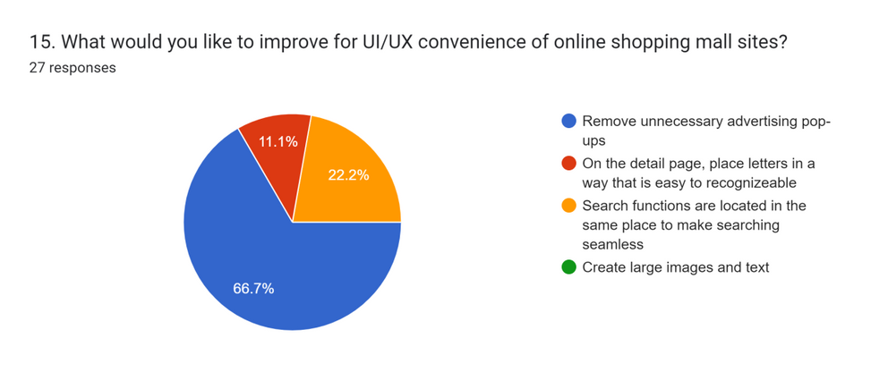
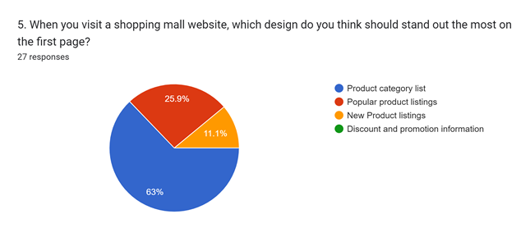
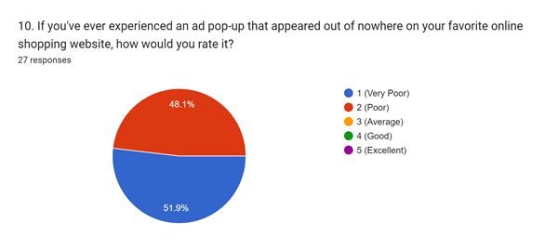
Questionnaire

Slide 10
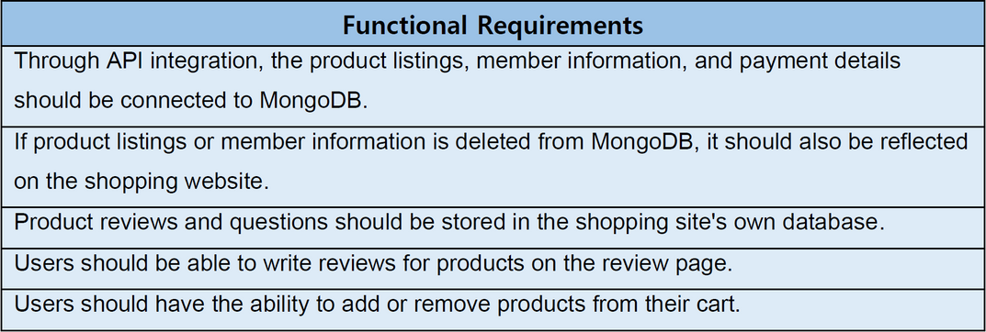
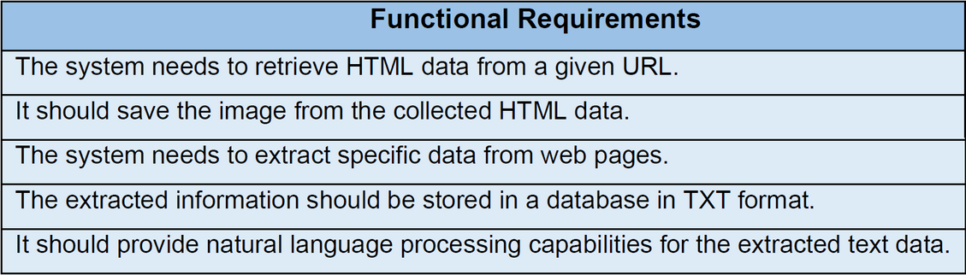
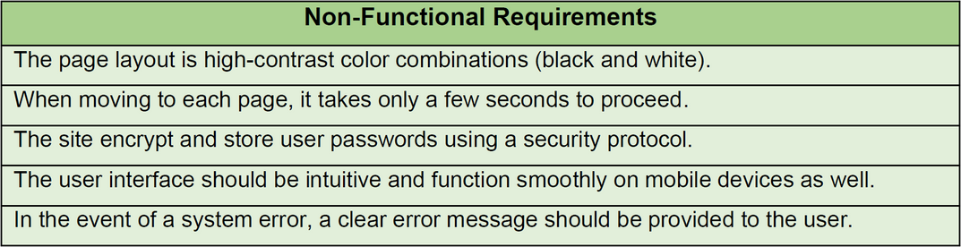
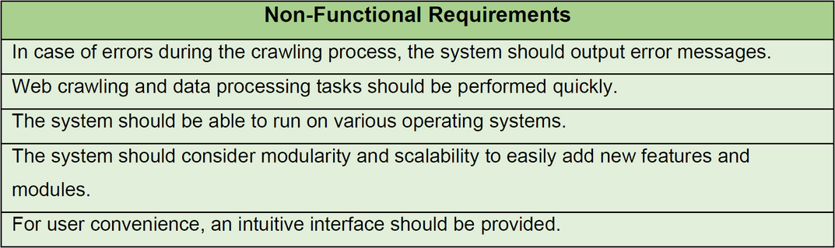
Online Shopping Site
Requirements
AI Web Crawling System
Requirements

Slide 11
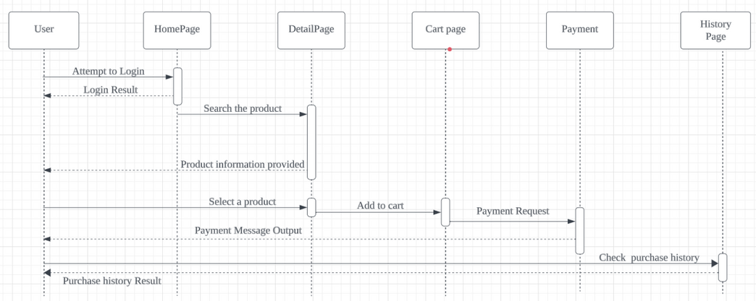
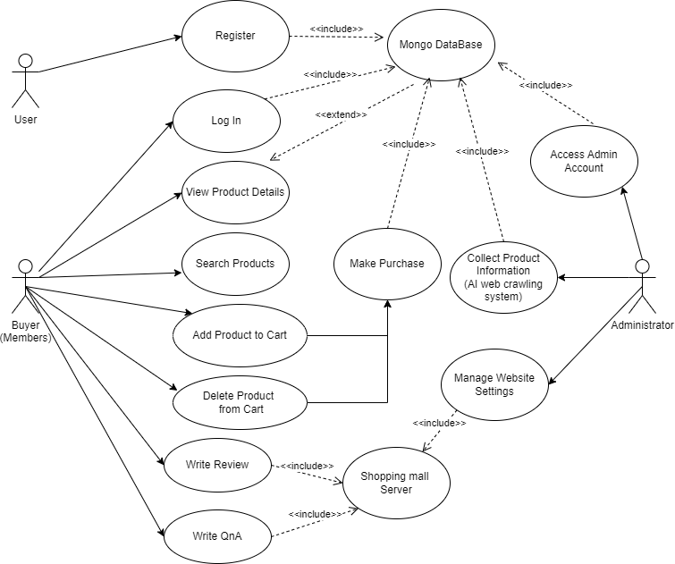
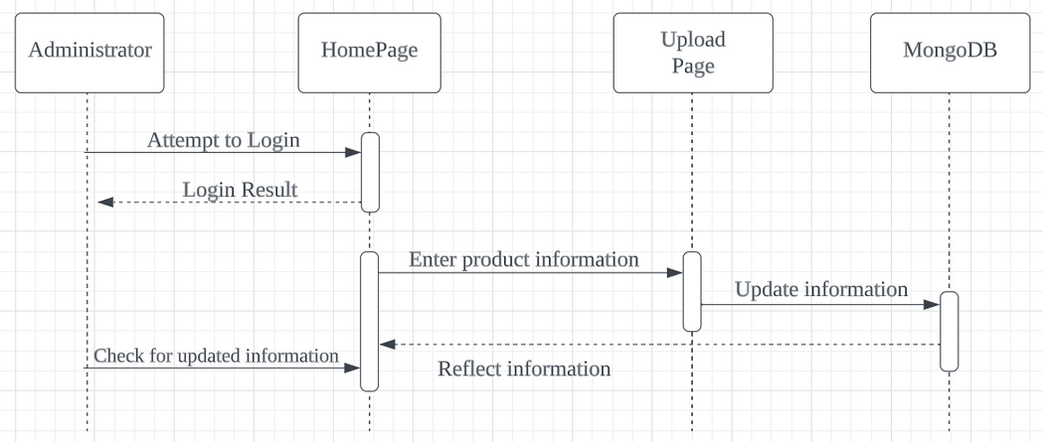
Use Case Diagram & Sequence Diagram for Online Shopping Site

Slide 12
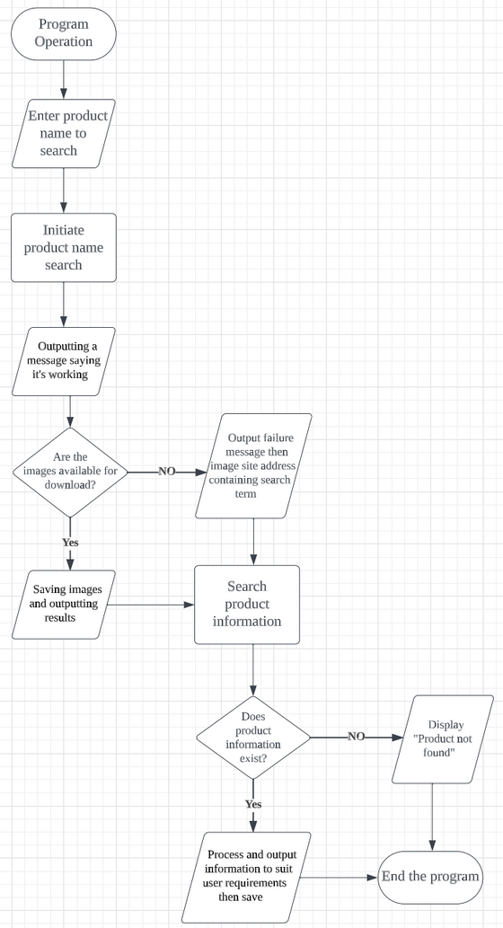
Flow Chart for the AI Web Crawling System

Slide 13
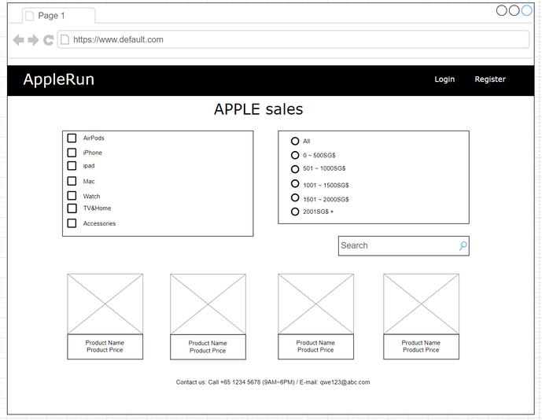
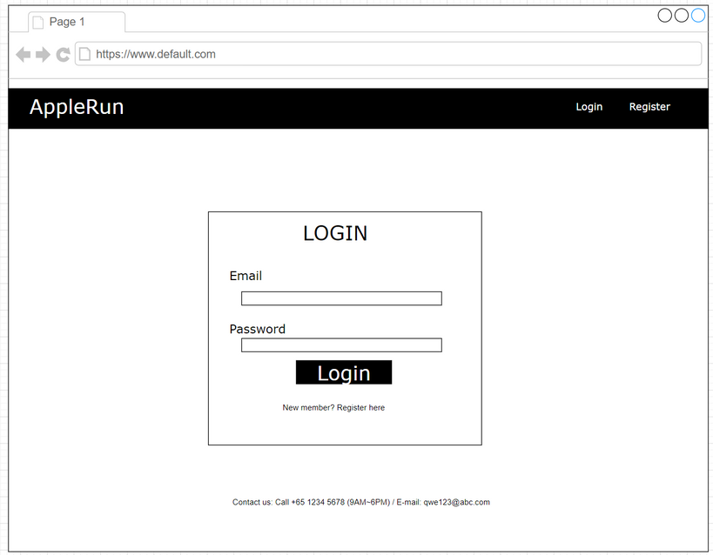
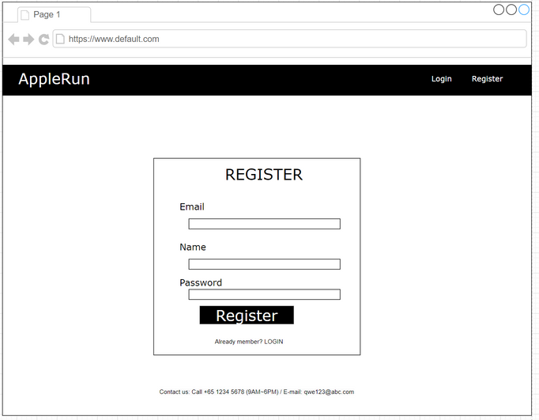
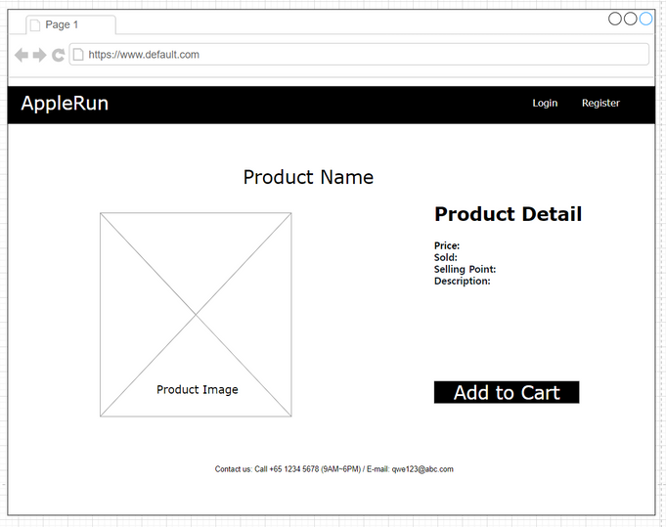
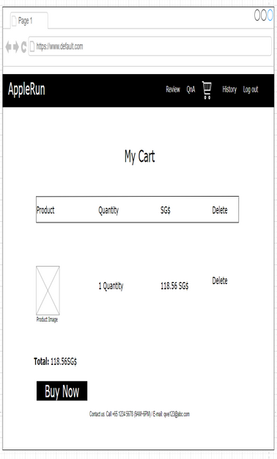
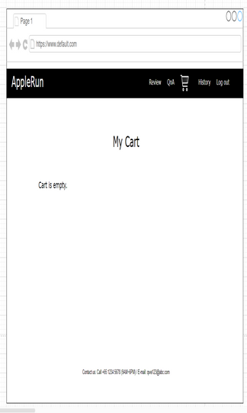
Prototype : Wireframe for Online Shopping site

Slide 14
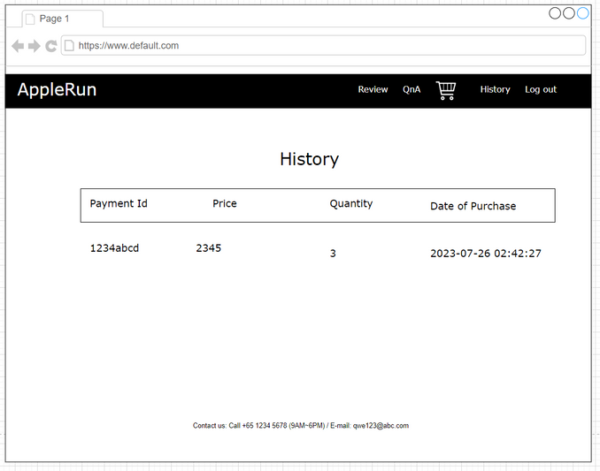
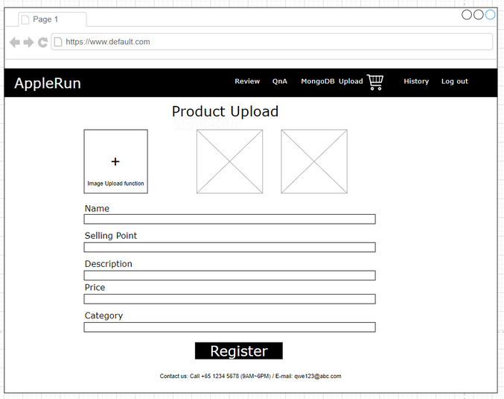
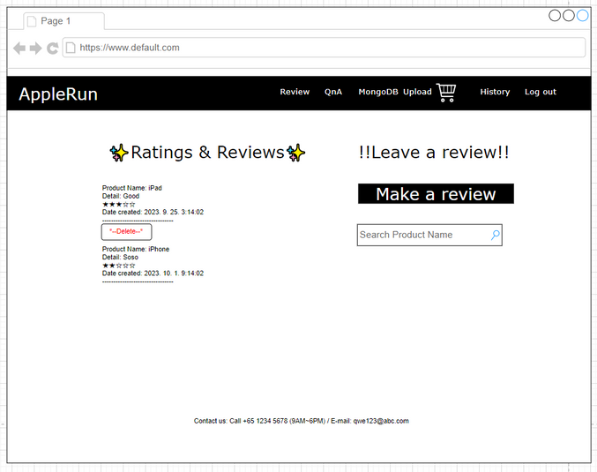
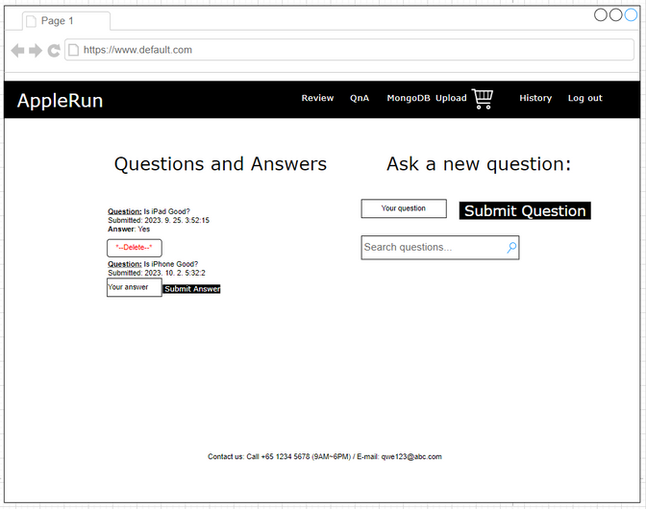
Prototype: Wireframe for Online Shopping Site

Slide 15
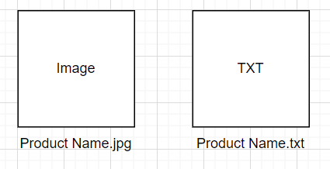
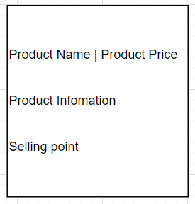
Prototype: Architecture for AI web crawling system
User interaction:
When the user executes the program, enter the product name to search.
User can obtain the product and requested description (sales pitch message) through the terminal or command prompt.
Program operation process:
Receive search keywords from the user.
Crawl the search results page of an online shopping site (Naver Shopping Mall) based on the entered keywords.
Extract product name, price, detailed information, and product image URLs from the crawled data.
Translate collected product names from Korean to English.
Download images using the URLs of the crawled product images. Images will be saved based on the translated product names in English.
Use an AI model to generate conversation messages based on the collected product information and specified requirements.
The AI model will generate messages that include product descriptions, price information, selling points, etc. The generated messages will be saved in a text file with the title being the translated product name in English.
Provide users with product information, image download links, AI-generated conversational messages, and more, all output to a terminal window.
Output file after running the program:
Contents of the txt file:

Slide 16




Achievements
Learned React and JavaScript for the first time, and successfully applied them in a project.
Built a project using MongoDB and UI/UX design principles learned from a previous class. Also incorporated the latest popular technology, GPT, into the project.
Mastered backend technologies for server and database management.
Improved skills in analyzing online survey data and organizing information.
Developed an AI-based web crawling system in Python, improving Python skills, AI understanding, and data analysis and machine learning abilities.

Slide 17
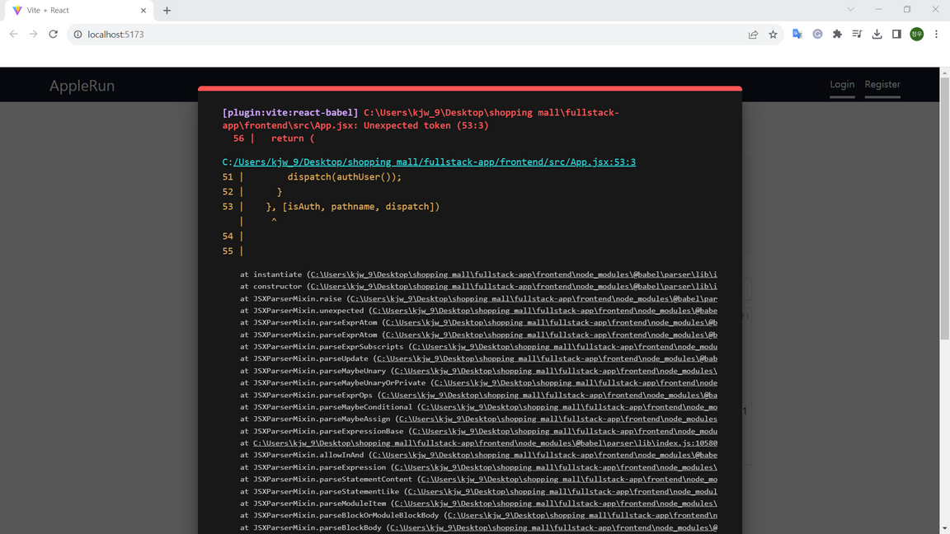

Challenges
Without GPT, converting and structuring data obtained through crawling would have been difficult.
Due to my limited knowledge in server configuration during the backend development process, unexpected delays occurred.
UI/UX survey responses were slow, causing unforeseen project delays.
A complex issue with a white screen during development required significant time and effort to resolve, posing a challenging task.

Slide 18

Thank you!
Please feel free to contact me
if you have any questions.

